Slide 1

Algebra 1
Unit 5, Lesson 5 Equations and Solutions in the Real World Volume 1, pg. 248

Slide 2


Benchmarks
MA.912.AR.2.1
Given a real-world context, write and solve one-variable multi-step linear equations.
MA.912.AR.9.6
Given a real-world context, represent constraints as systems of linear equations or inequalities. Interpret solutions to problems as viable or non-viable options.
volume 1, pg. 248

Slide 3
Integrated Mathematical Thinking and Reasoning Standards
MA.K12.MTR.1.1 Actively participate in effortful learning both individually and collectively.
MA.K12.MTR.2.1 Demonstrate understanding by representing problems in multiple ways.
MA.K12.MTR.3.1 Complete tasks with mathematical fluency.
MA.K12.MTR.4.1 Engage in discussions that reflect on the mathematical thinking of self and others.
MA.K12.MTR.6.1 Assess the reasonableness of solutions.
MA.K12.MTR.7.1 Apply mathematics to real-world contexts.
volume 1, pg. 248

Slide 4

Learning Targets
I can write and solve multi-step equations in a real-world context.
I can interpret solutions as viable or non-viable in a given context.
volume 1, pg. 248

Slide 5

Warm-Up
volume 1, pg. 249

Slide 6
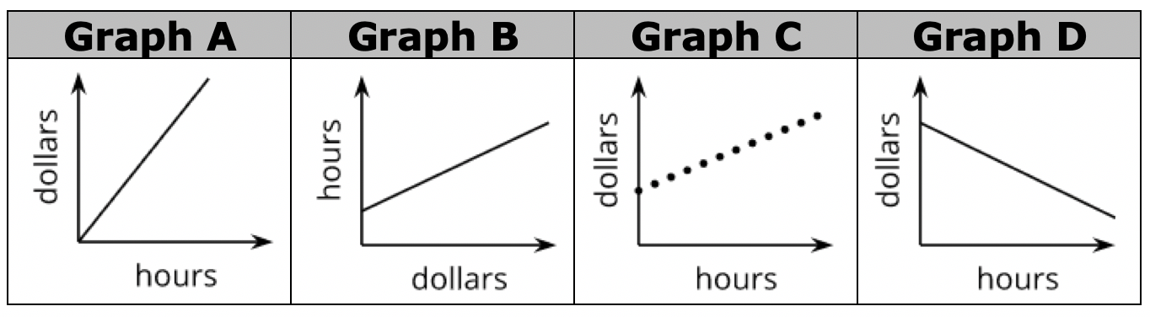
5.5.1 Warm-Up: Which One Doesn’t Belong?
Four graphs are shown.
volume 1, pg. 249

Slide 7
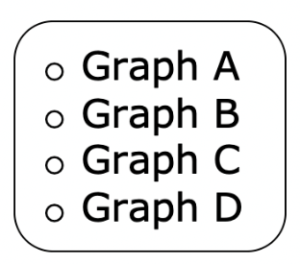
Complete the statement to explain which graph does not belong.
does not belong because ______________________________ __________________________________________________.
Find a classmate who selected a different graph that does not belong. Write their explanation in the table. You are the only person who should write in the first column of the table. Have the person initial next to your summary of their explanation stating that your summary is correct.
My Summary of ________________’s Description | Initials
volume 1, pg. 249

Slide 8

Guided Instruction
volume 1, pg. 249

Slide 9
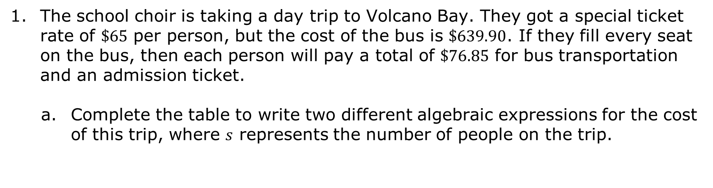
5.5.2 Guided Instruction: Writing and Solving Equations Representing Real-World Contexts
The school choir is taking a day trip to Volcano Bay. They got a special ticket rate of $\$65$ per person, but the cost of the bus is $\$639.90$. If they fill every seat on the bus, then each person will pay a total of $\$76.85$ for bus transportation and an admission ticket.
Complete the table to write two different algebraic expressions for the cost of this trip, where $s$ represents the number of people on the trip.
Expression A | Expression B
ticket rate per person plus the total bus cost | total amount paid per person, if all seats are full
volume 1, pg. 249

Slide 10
If all the seats on the bus are full, then Expression A and Expression B will be equivalent to each other. Therefore, they can be set equal to each other to create an equation.
Write and solve this equation.
volume 1, pg. 249

Slide 11

Interpret the solution in context.
Discuss with your partner why $52.7$ would not be a viable solution for this context. Summarize your discussion.
volume 1, pg. 250

Slide 12
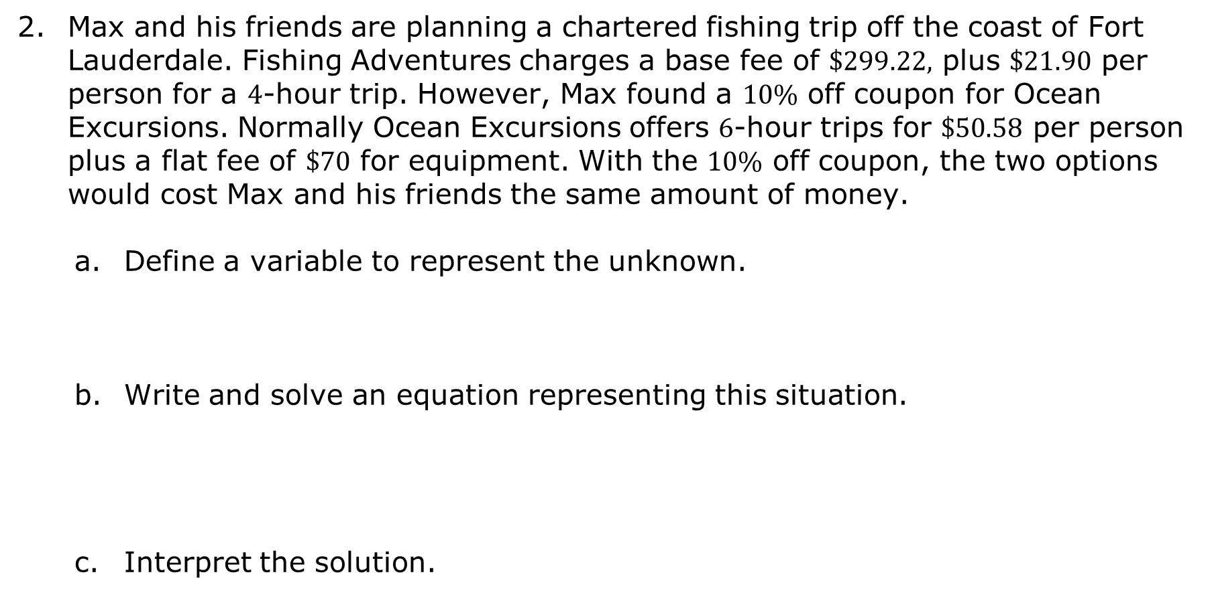
Max and his friends are planning a chartered fishing trip off the coast of Fort Lauderdale. Fishing Adventures charges a base fee of $\$299.22,$ plus $\$21.90$ per person for a $4$-hour trip. However, Max found a $10\%$ off coupon for Ocean Excursions. Normally Ocean Excursions offers $6$‑hour trips for $\$50.58$ per person plus a flat fee of $\$70$ for equipment. With the $10\%$ off coupon, the two options would cost Max and his friends the same amount of money.
Define a variable to represent the unknown.
Write and solve an equation representing this situation.
Interpret the solution.
volume 1, pg. 250

Slide 13

Guided Practice
volume 1, pg. 251

Slide 14

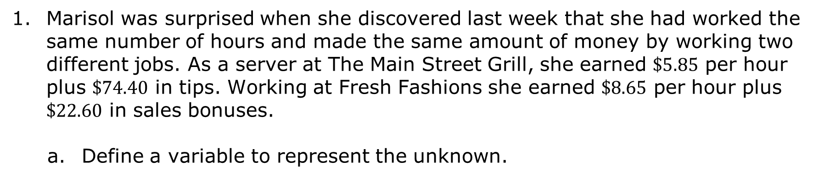
5.5.3 Guided Practice: Solving Real-World Problems by Writing and Solving Equations
Marisol was surprised when she discovered last week that she had worked the same number of hours and made the same amount of money by working two different jobs. As a server at The Main Street Grill, she earned $\$5.85$ per hour plus $\$74.40$ in tips. Working at Fresh Fashions she earned $\$8.65$ per hour plus $\$22.60$ in sales bonuses.
Define a variable to represent the unknown.
volume 1, pg. 251

Slide 15
Write an expression that represents the amount Marisol earned working at The Main Street Grill.
Write an expression that represents the amount Marisol earned working at Fresh Fashions.
Write the equation that represents last week, when she earned the same amount of money working the same number of hours at both jobs.
volume 1, pg. 251

Slide 16
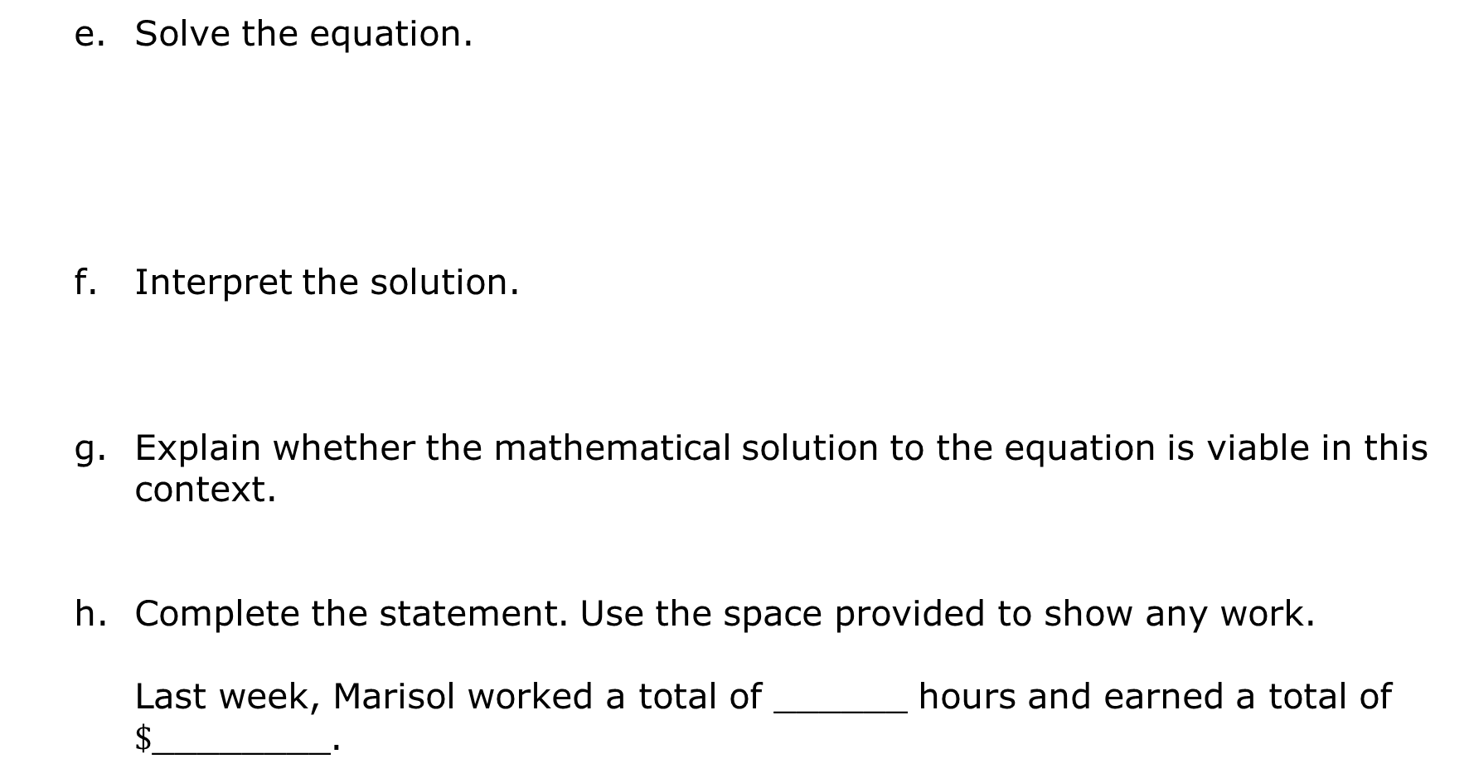
Solve the equation.
Interpret the solution.
Explain whether the mathematical solution to the equation is viable in this context.
Complete the statement. Use the space provided to show any work.
Last week, Marisol worked a total of ______ hours and earned a total of $\$$________.
volume 1, pg. 251

Slide 17
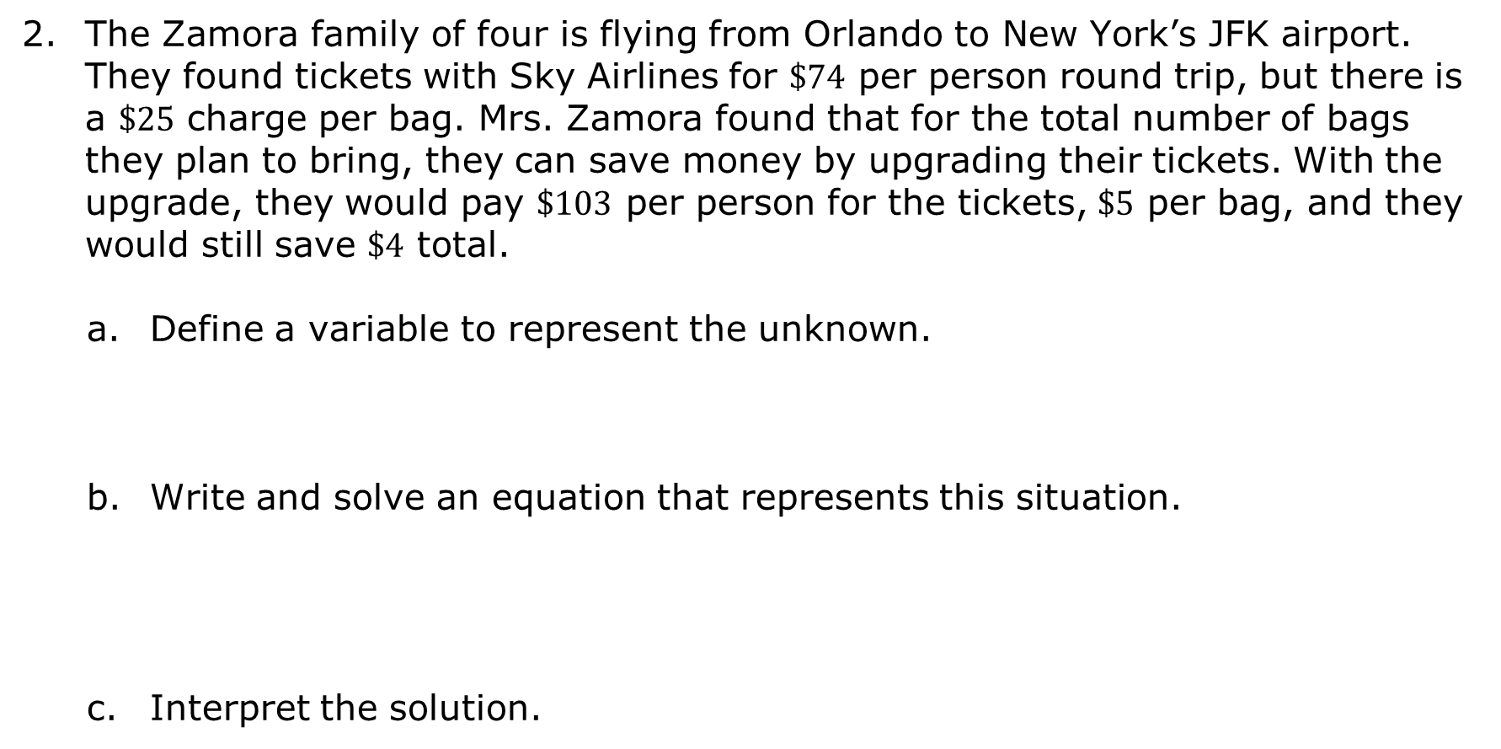
The Zamora family of four is flying from Orlando to New York’s JFK airport. They found tickets with Sky Airlines for $\$74$ per person round trip, but there is a $\$25$ charge per bag. Mrs. Zamora found that for the total number of bags they plan to bring, they can save money by upgrading their tickets. With the upgrade, they would pay $\$103$ per person for the tickets, $\$5$ per bag, and they would still save $\$4$ total.
Define a variable to represent the unknown.
Write and solve an equation that represents this situation.
Interpret the solution.
volume 1, pg. 252

Slide 18

Your Turn
volume 1, pg. 252

Slide 19
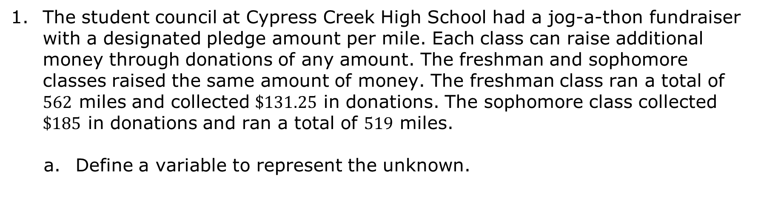
5.5.4 Your Turn!
The student council at Cypress Creek High School had a jog-a-thon fundraiser with a designated pledge amount per mile. Each class can raise additional money through donations of any amount. The freshman and sophomore classes raised the same amount of money. The freshman class ran a total of $562$ miles and collected $\$131.25$ in donations. The sophomore class collected $\$185$ in donations and ran a total of $519$ miles.
Define a variable to represent the unknown.
volume 1, pg. 252

Slide 20
Write and solve an equation that represents this situation.
Interpret the solution.
How much money did each class raise?
volume 1, pg. 252

Slide 21

Wrap-Up
volume 1, pg. 253

Slide 22
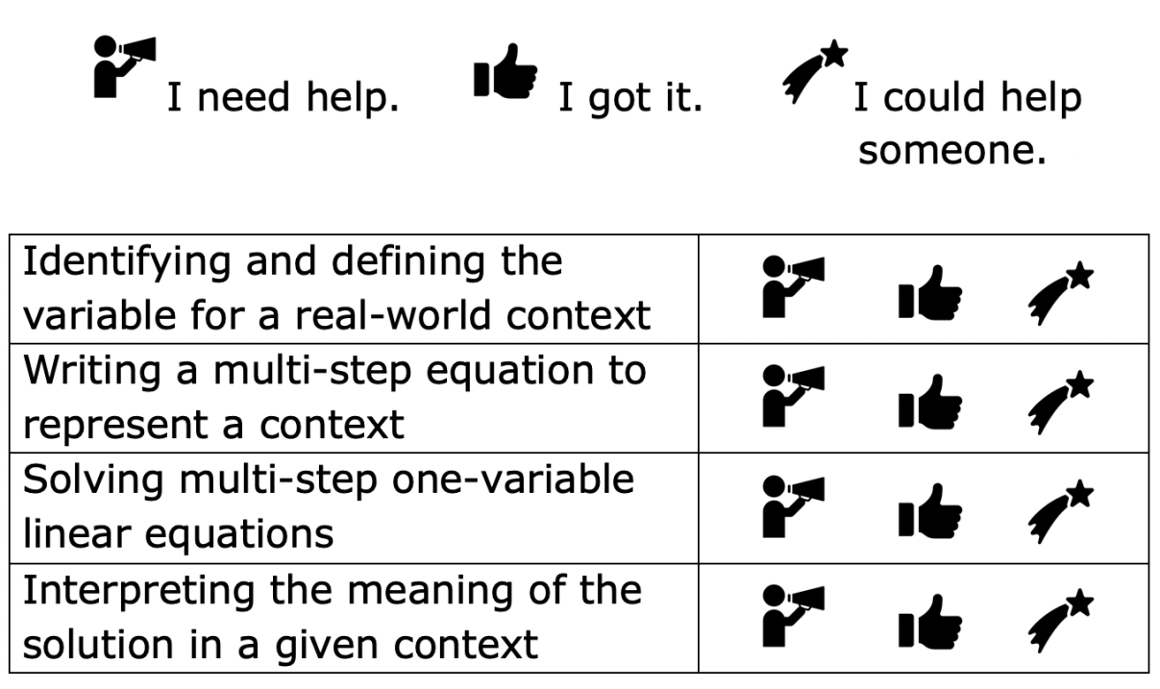
5.5.5 Wrap-Up: Reflection
Circle the icon that best describes your understanding of each.
volume 1, pg. 253

